Slide 1


Office of Energy Innovation
Vision
Our vision is that Wisconsin homes, businesses, and vehicles are powered with clean, efficient, reliable energy that creates jobs and grows our economy in an equitable manner where all can share in the benefits.
Mission
Developing Wisconsin’s energy landscape to be secure, environmentally responsible, and growing the state’s economy for all.
Programs
State Energy Office: Grant Programs, Technical Assistance, Energy Statistics & Data, Energy Security
https://psc.wi.gov/Pages/Programs/OEI.aspx
Focus on Energy: Incentives & Rebates, Technical Assistance, Training, Trade Ally Support
www.FocusonEnergy.com
Contact: OEI@Wisconsin.gov
Stakeholder Engagement Lead: Nicholas.Labinski@wisconsin.gov
Notes:
Joe
4 Pillars of the SEO: Grant Programs, Technical Assistance, Energy Statistics & Data, Energy Security

Slide 2

IRA HER Programs
Tribal members are eligible to apply for the HOMES and HEAR program, being delivered by Focus on Energy. (IRA Home Energy Rebates | Focus on Energy)
All tribal members can apply for the state's program
Notes:
Gina / Caitlin – this data is up to date
Joe can handle the screenshare of the OEI Map

Slide 3
Energy Innovation Grant Program-Program Update
Program funds from 2009 American Recovery and Reinvestment Act (ARRA) and last year a one-time IIJA infusion
Over 100 total projects funded over 5 rounds
There will be another round—Date TBD
Notes:
Gina / Caitlin – this data is up to date
Joe can handle the screenshare of the OEI Map

Slide 4
IRA – Contractor Training Grants (TREC)
State-Based Home Energy Efficiency Contractor Training Grants – WI Allocation $2.8M
The State-Based Home Energy Efficiency Contractor Training Grants (Contractor Training Program) makes funding available to state energy offices so they can train, test, and certify workers to deliver energy efficiency, electrification, and home energy improvements, including those improvements covered under the HOMES and High-Efficiency Electric Home Rebate Program.
Docket: 9718-FG-2023
Program Status: Application submitted to U.S. DOE on 1/31/24 ($2.8 million)
—Contingent Award in January 2025, waiting further information from DOE
Notes:
Nick

Slide 5
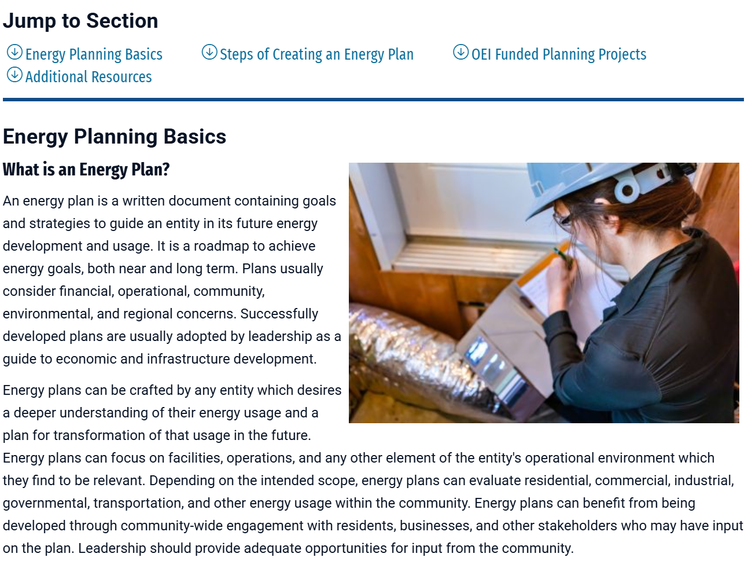
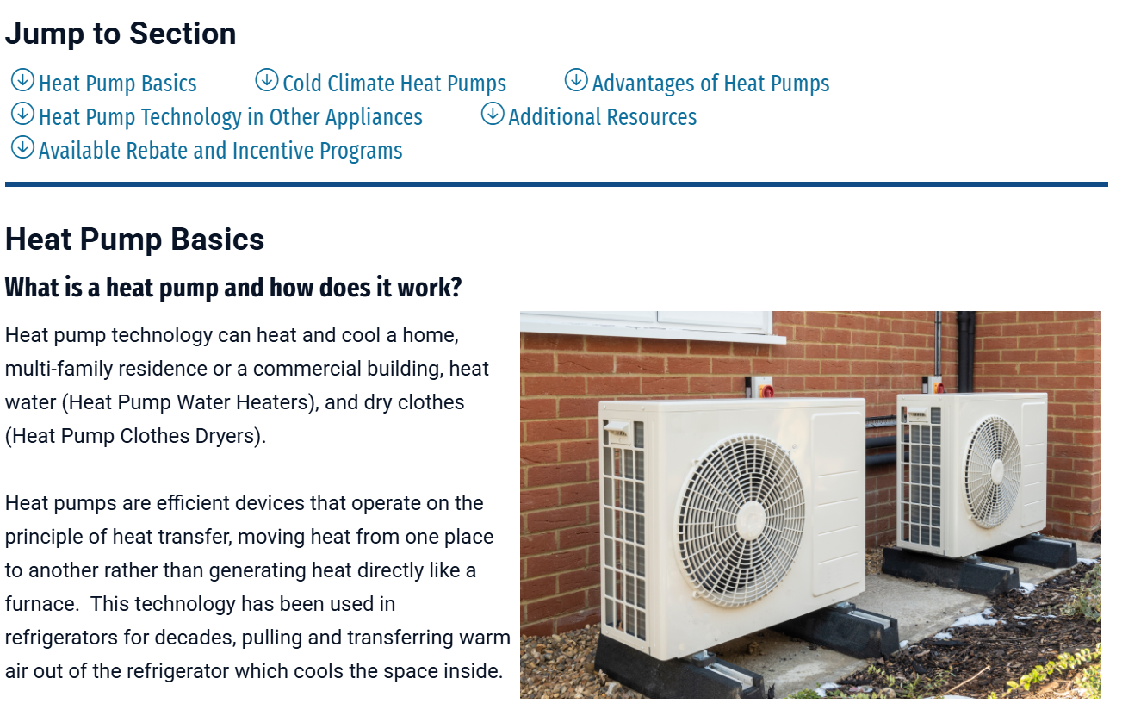
Other OEI Updates
New Technical Assistance Pages for Energy Planning and Heat Pumps
PSC Energy Planning
PSC Heat Pumps
Notes:
Nick

