Slide 1
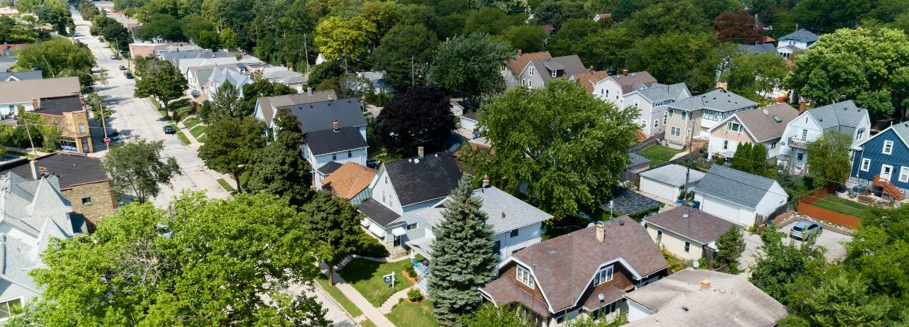
IRA Home Energy Rebates Tribal Symposium 2025
Dylan Crye – IRA Program Manager

Slide 2

agenda
October 2025 update
Brief program refresher
Navigating the HEAR program
Additional resources

Slide 3
October 2025 state programs Update
Both HOMES & HEAR Programs are fully live and active in Wisconsin!
Multifamily buildings left ‘pilot’ status earlier this month.
Retail appliances are available for direct customer purchase as
An instant discount at Lowe’s.
A rebate paid to customer after product purchased at any retailer.

Slide 4
Program comparison: Homes vs HEAR
 | HOMES | HEAR
SAVINGS | Performance-based whole-home rebates. | Contractor Installed – Instant discount on invoice. Retail – instant discount at select retailers or rebate applied for after purchase.
UPGRADE TYPE | Not specific to any one technology. But not all technologies allowed. | Qualifying electric appliances and home upgrades.
WHO IS ELIGIBLE? | All Wisconsin residents. Rebates based on based on predicted savings and household income. | Low- and moderate-income households (<150% Area Median Income). New construction is eligible for some upgrades.
BASIC REQUIREMENTS | Existing homes only and requires an energy assessment. Must use an IRA Registered Contractor. | Contractor Installed - Equipment must be purchased and installed by an IRA Registered Contractor. Retail – can be purchased at any retail location and installed at a qualified household.
RETROACTIVE | Yes | No
IRA Rebates may also be combined with Focus on Energy rebates and discounts, the Weatherization Assistance Program, and tax credits.

Slide 5
Tribal Member participation paths: State vs Tribal program
Focus on Energy Portal
HOMES (State)
HEAR (State)
Find a Registered Contractor
1. Income Qualification
2. Program
3. Upgrade Type
HEAR*** (Tribal)
Find a Registered Contractor
Retail Product Portal
TBD**
*Either or, not both
All tribal members that live in Wisconsin are eligible to participate fully in both state HOMES and HEAR programs, the only restriction is they cannot participate in both state and tribal HEAR programs, it is one or the other.

Slide 6
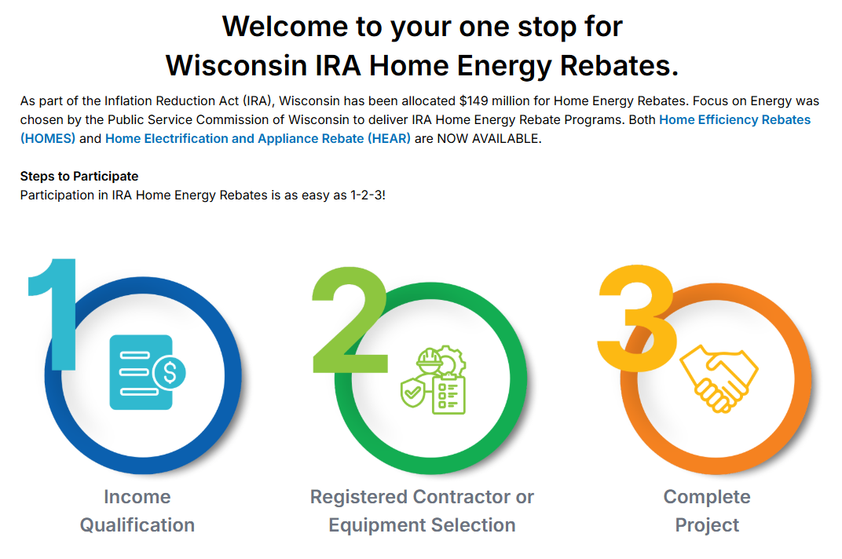
Focus Webpage
focusonenergy.com/home-energy-rebates
Income qualification.
Program pages.
Rebate amounts.
FAQs.
IRA Registered Contractor info.

Slide 7
HOMES Program
Home Efficiency Rebates

Slide 8
Homes: Modeled rebates
Per Unit Rebates | Low-Income (<80% AMI) | Moderate-Income (80%-150% AMI) | High-Income (>150% AMI)
Project with at least 20% predicted energy savings | 100% of project costs up to $5,000 | 50% of project costs up to $2,000 | 50% of project costs up to $1,500
Project with at least 35% predicted energy savings | 100% of project costs up to $10,000 | 50% of project costs up to $4,000 | 50% of project costs up to $3,000
Moderate- and Higher-Income Multifamily properties have a rebate cap of $200,000 (20%-34% savings) or $400,000 (35%+) per building.
Low-income are 250,000 (20%-34% savings) or $500,000 (35%+) per building.

Slide 9
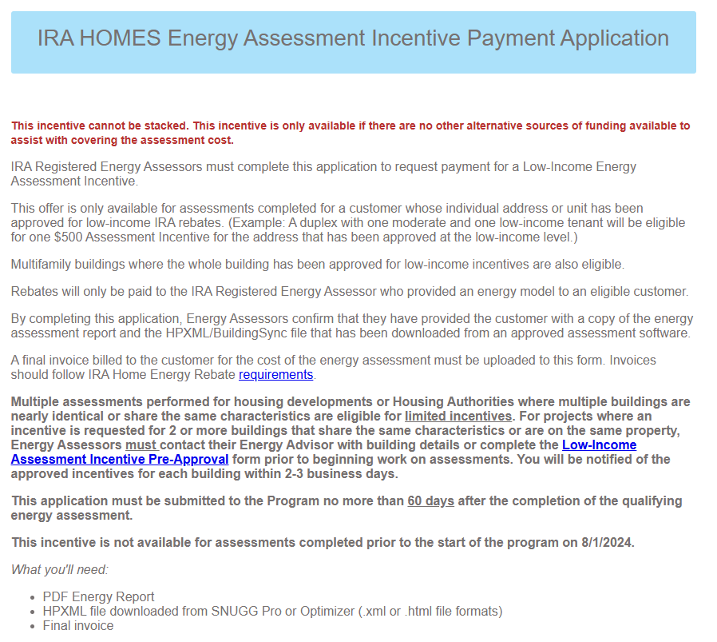
Homes: Low-Income Assessment Instant Discount
Must be provided as an instant discount to the household.
Up to $500 per unit paid direct to the Assessor.
Up to $2,000 per Multifamily property.
Assessment must include a calibrated model & report.
Only for HOMES projects.
Low Income Energy Assessment Incentive Application

Slide 10
HEAR Program
Home electrification and Appliance Rebates

Slide 11

HEAR Program
Only Low- and moderate-income households are eligible.
Under 150% Area Median Income (AMI).
Instant discount on qualifying electric appliances and home upgrades when installed by a Registered Contractor.
Instant discount coupon available for retail purchases at Lowes.
Post purchase rebate available for qualifying purchases made at other retailers.

Slide 12
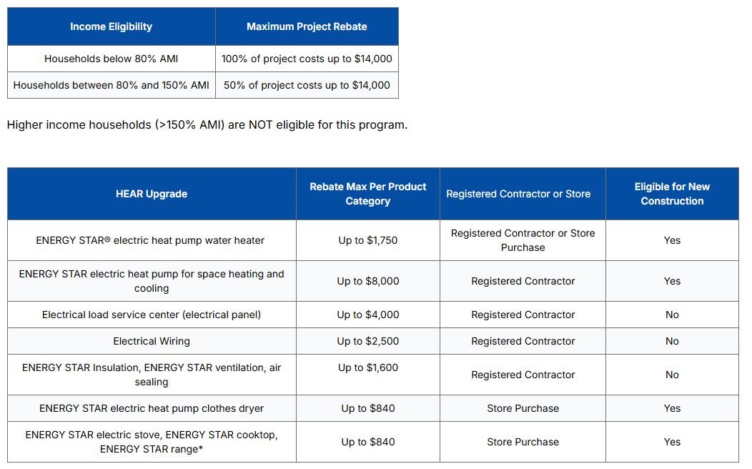
HEAR rebates
focusonenergy.com/ira-hear
*Rebates are available only when upgrading from a non-electric appliance.

Slide 13
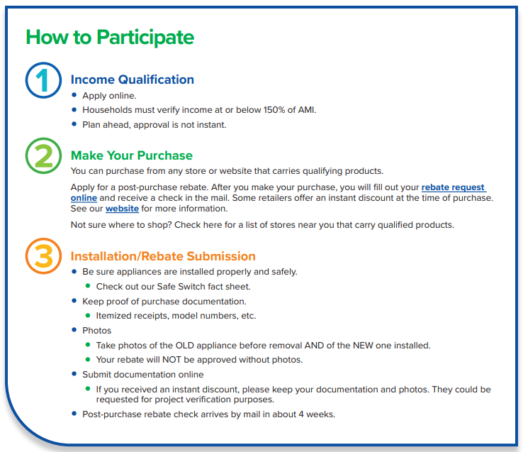
Retail Purchase Program Guide
*Or work with Registered Contractor for all other HEAR upgrades
*

Slide 14
Retail Purchase Program Guide
https://assets.focusonenergy.com/production/IRA/Retail-Program-Participation-Guide_10-25.pdf

Slide 15
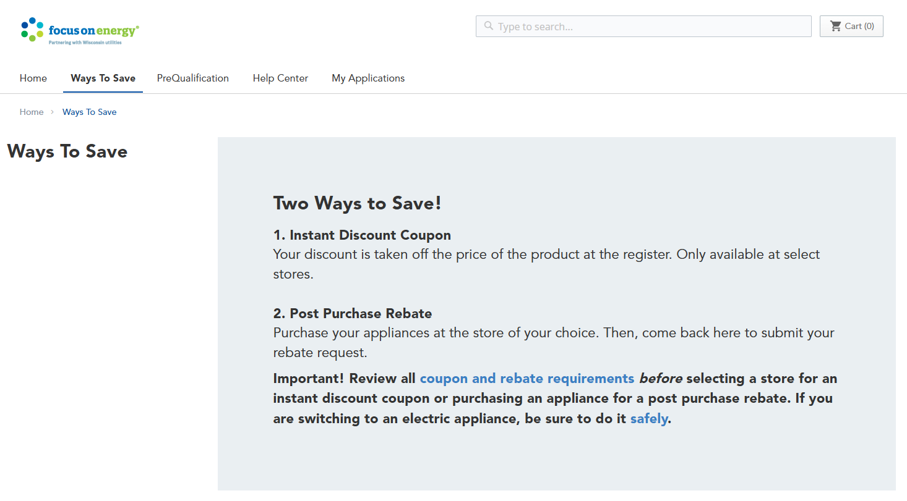
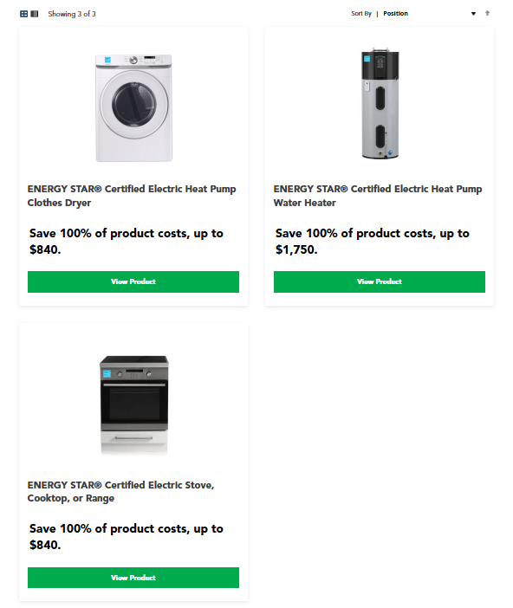
Customer Portal – Retail

Slide 16
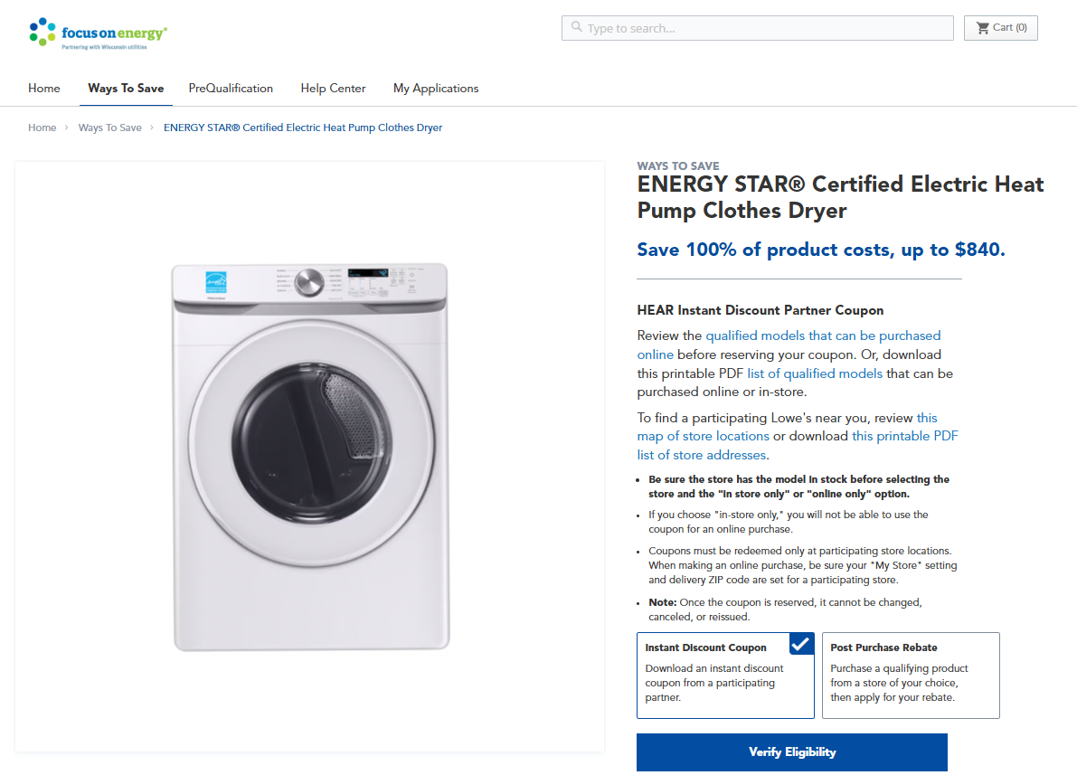
Customer Portal – Retail
Instant Discount or Post Purchase Rebate
Qualified Product Lists
Store locators
Lowe’s
Partner Stores

Slide 17
Additional Resources

Slide 18

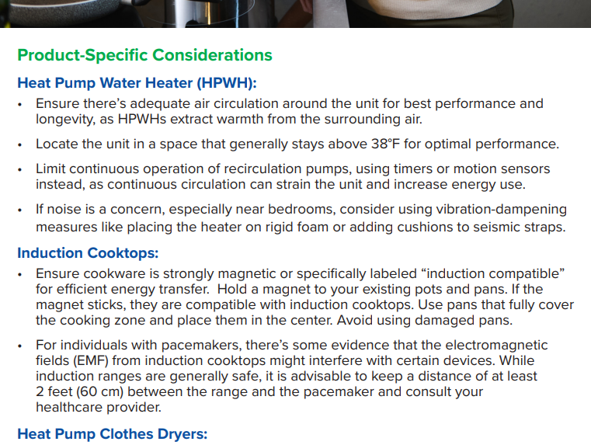
HEAR Program – Safe Switch
https://assets.focusonenergy.com/production/IRA/Safe-Switch-Conversion-Safety-Info-Sheet_9-30-25.pdf

Slide 19
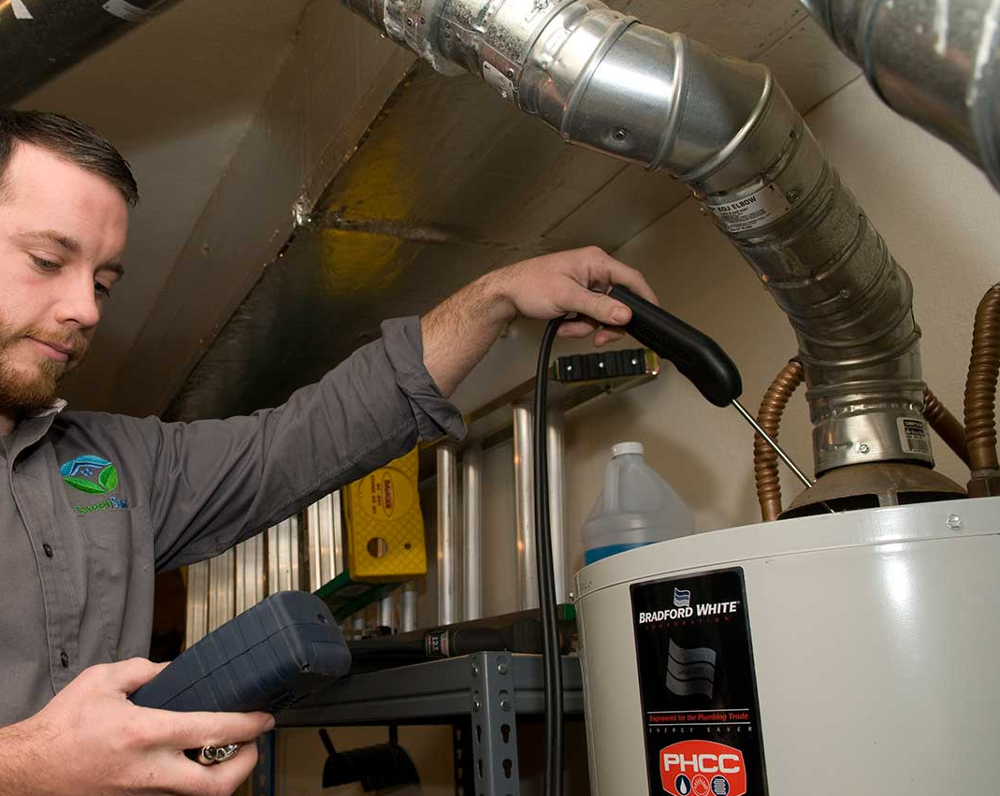
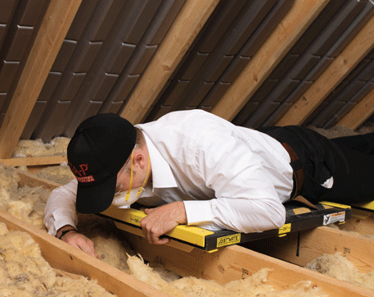
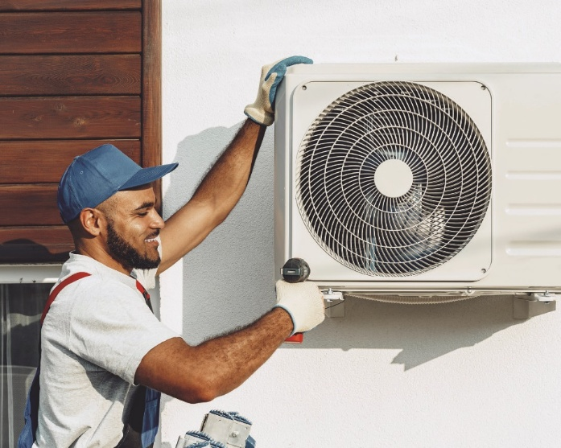
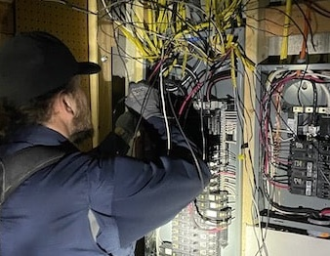
IRA Registered Contractor Network
Separate from Focus on Energy Trade Ally Network.
Separate participation requirements.
Additional training requirements.
Additional documentation.
How to register: focusonenergy.com/ira-registered-contractors

Slide 20
Nancy Alberte – Energy Advisor, Tribal IRA
Nancy.Alberte@focusonenergy.com

Slide 21
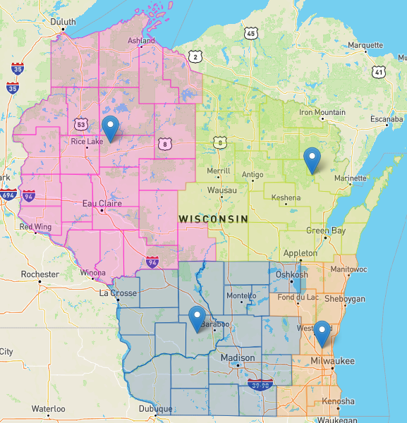
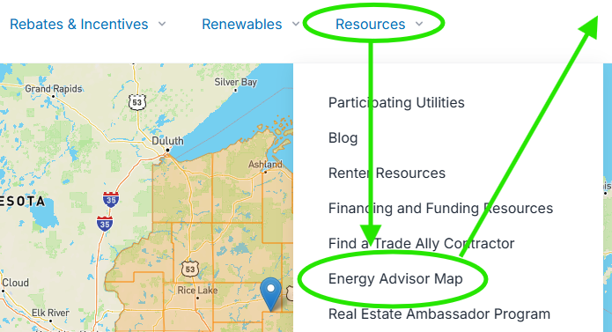
IRA Energy Advisors
Energy Advisors are program staff available to assist contractors, businesses, local governments and tribes participate in Focus.
Not sure which one to work with? Email: IRAHER@focusonenergy.com
focusonenergy.com

