Slide 1
Demand control ventilation (dCV)
Tad Beeksma
October 29, 2025

Slide 2
Demand control Ventilation (dCV)
What is Demand Control Ventilation?
Commercial buildings are required by code to bring in outside air
Heating, cooling and dehumidifying that air costs $$$
Demand control ventilation is a method of controlling HVAC equipment so it brings in only what’s needed
For casinos, the amount you can save is huge

Slide 3
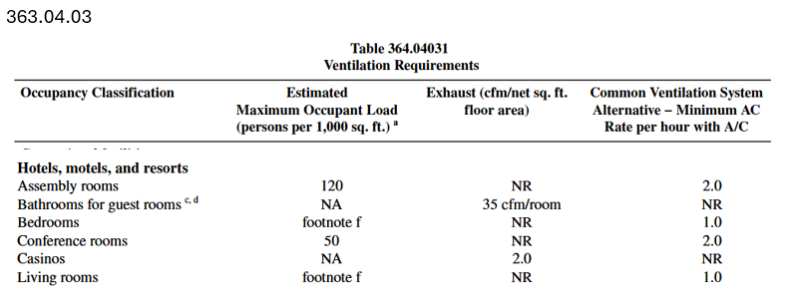
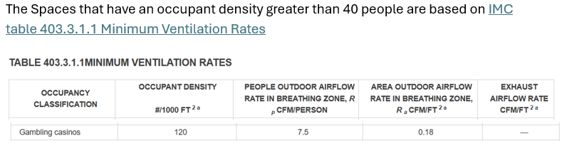







Casino Ventilation Codes

Slide 4
Casino Ventilation history
Why were the Wisconsin code requirements set where they were?
Wisconsin = 2.0 cfm/sqft
International Code = 0.18 cfm/sqft (non-smoking)
I asked Randy Dahman
The main reason is smoking
High cooling loads due to people and equipment was also a consideration
There are pacts that need to be referenced that may require a particular casino to conform to state codes

Slide 5
What has changed?
Smoking – This is a big one
If there is still smoking allowed, you’ll need to ventilate to get rid of that
If not, there’s big potential for energy savings
If smoking can be contained to one area, then some equipment can have ventilation changes made (anyone remember smoking sections in restaurants?)

Slide 6
What has changed?
Heat from Electronics and Lighting
Technologies have changed in recent years
LEDs in the gambling machines and for lighting contribute much less heat
The electronics are much more efficient in the machines
If energy recovery is done via wheels, plates heat exchangers, or run around loops, the cooling load is greatly reduced as well
It all adds up to a lower cooling load than when most casinos were built

Slide 7
Implementing DCV
Demand control ventilation isn’t anything new
Required by code in many cases for new construction of non-casino facilities
Implementation is usually accomplished by installing carbon dioxide sensors
Some engineers worry about the sensors being wrong (drift). Using alarms in the controls will catch this

Slide 8
Implementing DCV
Apprehensive? Try installing DCV in one area and see how it goes
DCV can be disabled very easily in the controls or overridden
Payback of a less than a year (Around $5,000 to install for 1 rooftop or air handler)
We give an incentive if you have a participating utility
Once they’re in, add the sensor calibration to the annual maintenance plan
Demand Control Ventilation works for any area, but large spaces with variable occupancy are the best opportunities for savings

